Slide 1


Join at slido.com
#3348181
ⓘ
Click Present with Slido or install our Chrome extension to display joining instructions for participants while presenting.
Notes:
📣 This is Slido interaction slide, please don't delete it.
✅ Click on 'Present with Slido' and the joining instructions will appear when you get to this slide.

Slide 2
Exploratory Data Analysis (EDA) IV
⚠️ Reminder to start the Zoom recording!
⚠️ Reminder to start Askademia!
LECTURE 5
Missing data, arriving at a conclusion, and key EDA concepts.
Data C100/Data C200, Fall 2026 @ UC Berkeley
Ramesh Sridharan and Jeremy Sanchez
Content credit: Acknowledgments

Slide 3
📣 Announcements
HW 1 due tomorrow!

Slide 4
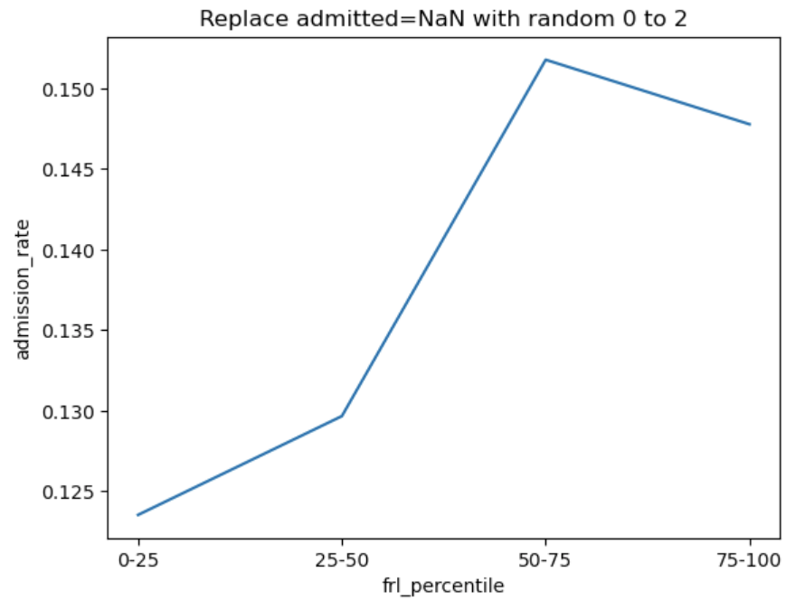
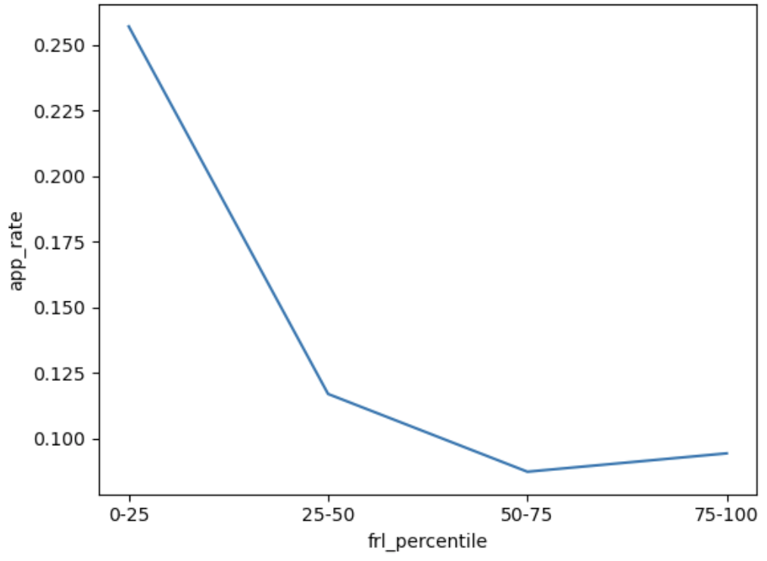
Admission rates have a different pattern
What's going on here?

Slide 5



Do not edit
How to change the design
What could be responsible for the reversed pattern in admission?
Presenting with animations, GIFs or speaker notes? Enable our Chrome extension
Notes:
📣 This is Slido interaction slide, please don't delete it.
✅ Click on 'Present with Slido' and the poll will launch automatically when you get to this slide.

Slide 6
Admission rates have a different pattern
What's going on here?
Selection effects: Stronger students are the most likely to still apply when app_rate is low.
UC admissions policy: Top K at high schools in California. If low # apply, do most get in?

Slide 7
Do not edit
How to change the design
How should we compute attendance rates for each frl_percentile? How do we handle null values?
Presenting with animations, GIFs or speaker notes? Enable our Chrome extension
Notes:
📣 This is Slido interaction slide, please don't delete it.
✅ Click on 'Present with Slido' and the poll will launch automatically when you get to this slide.

Slide 8
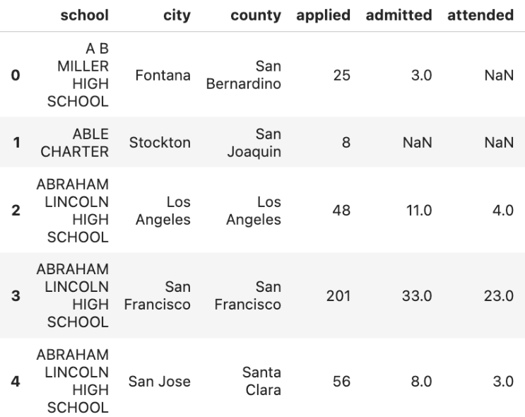
Missing Data: Redux
Attendance rates are trickier, since admitted can also be NaN!
Here is one possible approach:
Ignore the rows with admitted=NaN and attended=NaN.
Otherwise, replace attended=NaN with a random value between 0 and 2
Should we do a stability check of our method? Probably! For the sake of lecture time, we will proceed with this approach.

Slide 9
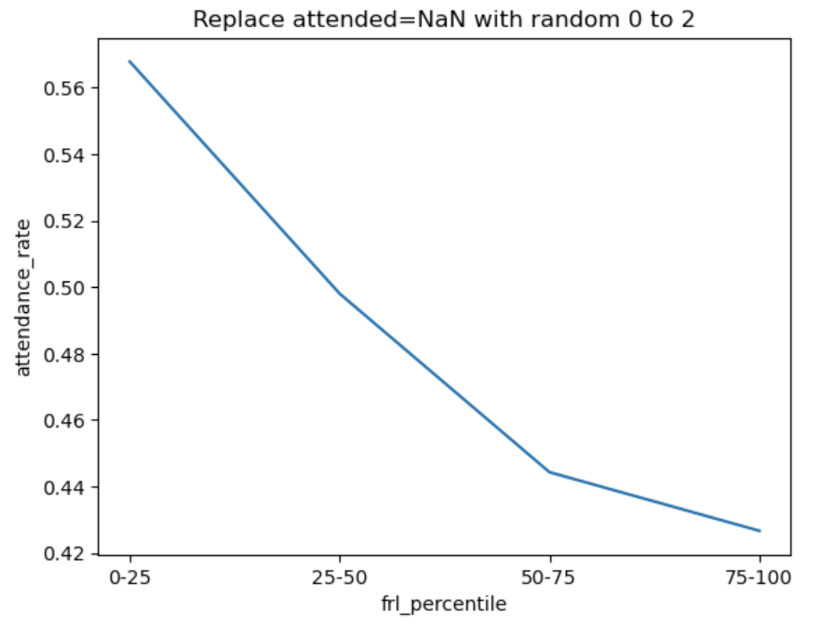
Yield rates have a different pattern
What's going on here?
Attending college is expensive!
Maybe Berkeley knows that yield rates are lower at high FRL schools, so they admit more students from those schools to compensate?

Slide 10
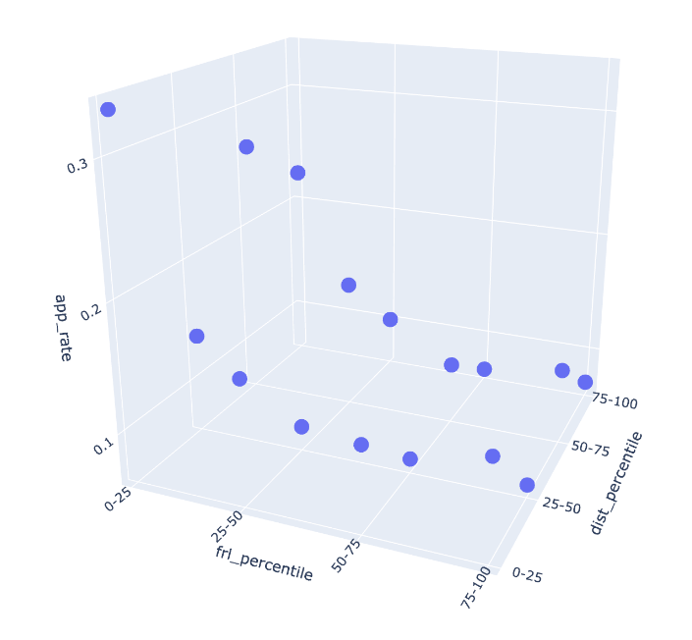
Bringing in an additional variable
Holding FRL status constant, perhaps students who live closer to Berkeley are more likely to attend than students who live far away.
How readable is this 3D plot?
Our data has three dimensions, but plots should be 2D.
Are we stuck?
We have other dimensions to work with!
Color, size, shape, linetype, shading, ...

Slide 11
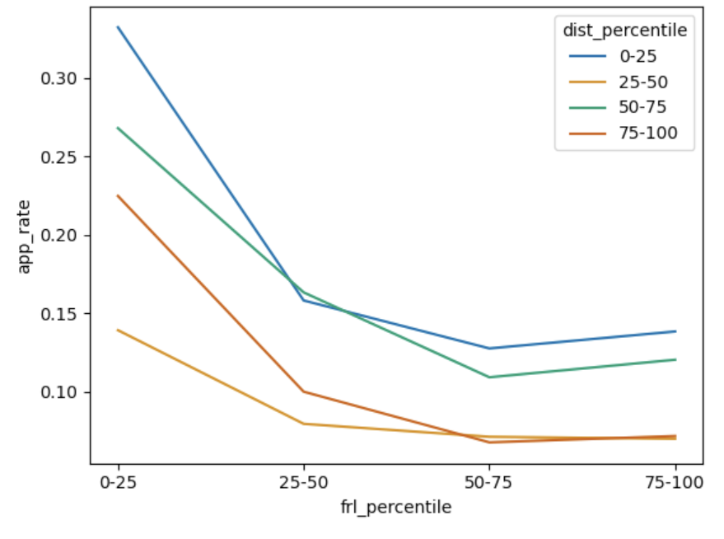
Adding a new variable with color
How would you describe the patterns in the right plot to someone else?
Same data!

Slide 12
Do not edit
How to change the design
How would you describe the patterns in this plot to someone else?
Presenting with animations, GIFs or speaker notes? Enable our Chrome extension
Notes:
📣 This is Slido interaction slide, please don't delete it.
✅ Click on 'Present with Slido' and the poll will launch automatically when you get to this slide.

Slide 13
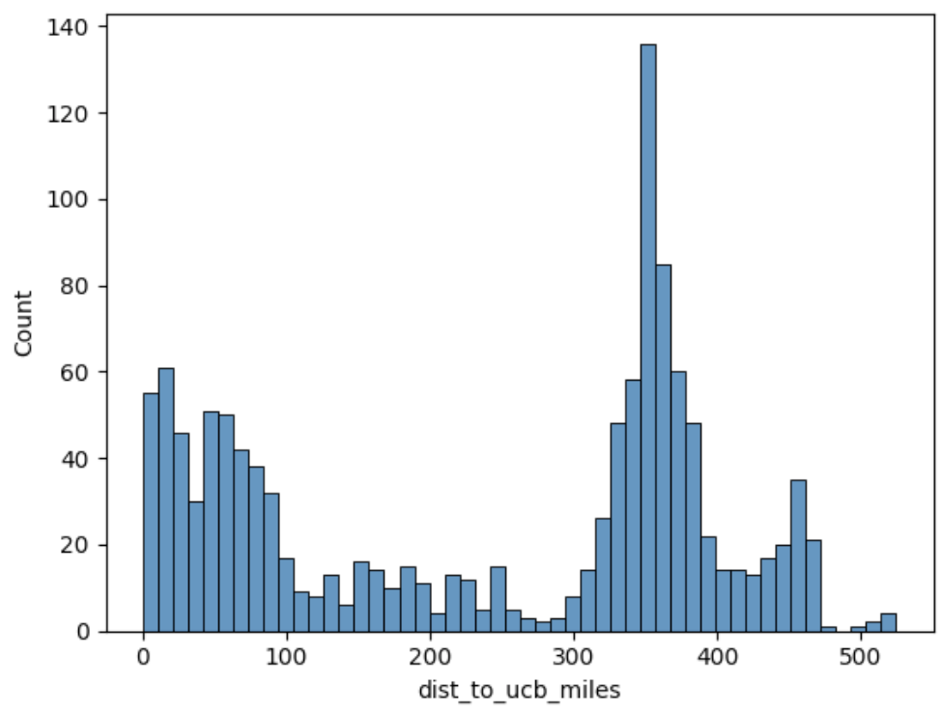
Adding a new variable with color
Anything unexpected in this plot?
Why is the 25-50 line at the bottom?
Hypothesis: Something to do with Central Valley schools (e.g., Bakersfield)? Perhaps more customary to not apply to Berkeley?

Slide 14
Do not edit
How to change the design
How many rows are in the data used to make this plot? How many columns?
Presenting with animations, GIFs or speaker notes? Enable our Chrome extension
Notes:
📣 This is Slido interaction slide, please don't delete it.
✅ Click on 'Present with Slido' and the poll will launch automatically when you get to this slide.

Slide 15
Tidy Data: Redux
Rows: How many data points are in the plot?
Columns: How many variables are in the plot?
16 data points → 16 rows
3 variables → 3 columns
frl_percentile | dist_percentile | app_rate
Seaborn Code
sns.lineplot(df, x='frl_percentile', y='app_rate', hue='dist_percentile')

Slide 16
Returning to our original question
Task: Your manager asks you to identify five California public high schools that defy typical patterns of application, admission, and/or attendance.
We have learned a lot so far:
High FRL schools tend to have lower apply rates, higher admit rates, lower attend rates.
Schools far from Berkeley tend to have lower apply rates.
But, schools in the Central Valley tend to have especially low apply rates, even though they are closer to Berkeley than schools in LA or San Diego.
There is a lot more to explore. For example:
How does distance relate to admit rates and attend rates?
How do charter schools compare to non-charter schools?
Large schools versus small schools?
Are there similar patterns for UCLA (sort of the "Berkeley of Southern California")?

Slide 17
Returning to our original question
Task: Your manager asks you to identify five California public high schools that defy typical patterns of application, admission, and/or attendance.
We could explore more, but it's the end of the day. Our manager wants an answer.
We have to make some decisions about our "pool" of schools to select from. For example:
Should we exclude small schools?
Should we exclude charter schools?
Do we care more about application, admission, or attendance?
Do we want our selected schools to be representative of California as a whole? For example, is it OK if they are all in the Bay Area?
Should we consider schools with imputed admission and/or attendance rates?

Slide 18
Returning to our original question
Task: Your manager asks you to identify five California public high schools that defy typical patterns of application, admission, and/or attendance.
Here is one way to approach the problem. There is no "correct" way!
Let's focus on schools with at least 100 12th graders.
Let's ignore charter schools.
Let's focus on application rates, since this is one distinct student action for us to target.
We are open to identifying a school with low or high application rates.
Geographic representation: Make five dist_from_ucb buckets and select one school from each bucket.
With the constraints above, let's make a scatterplot of free_reduced_percentage and app_rate for each of our five geographic buckets.

Slide 19
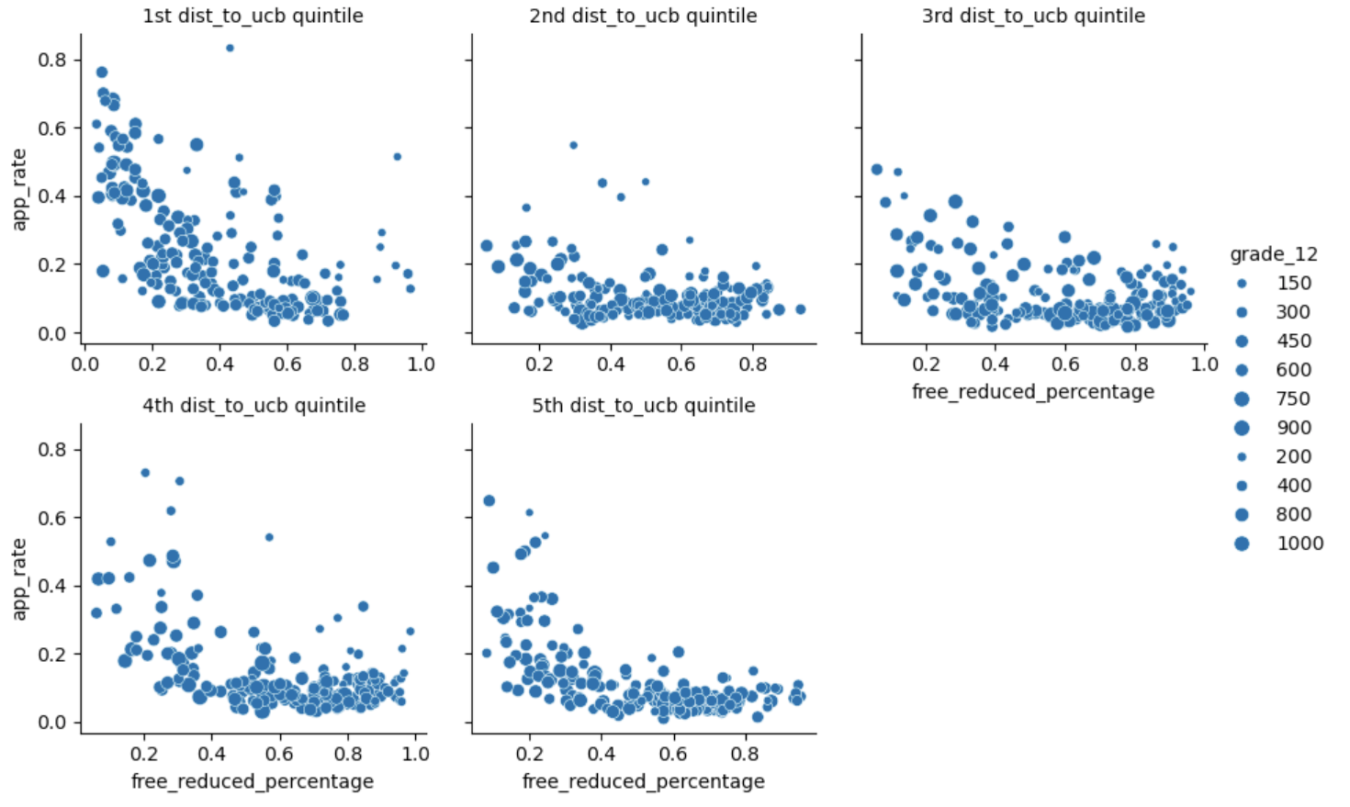
Do any schools stand out?

Slide 20
Structure -- the "shape" of a data file
Granularity -- how fine/coarse is each datum
Temporality -- how is the data situated in time
Faithfulness -- how well does the data capture "reality"
Key Data Properties to Consider in EDA

Slide 21
Rectangular Data
Fields/Attributes/
Features/Columns
We often prefer rectangular data for data analysis
Easy to manipulate and analyze
Big part of data cleaning: Reshape to be more rectangular
Example: text file of spam emails → table of word counts
Two kinds of rectangular data: Tables and Matrices.
Records/Rows
Tables (DataFrames in R/Python)
Named columns with different types
Manipulated w/ data transformation functions (group by, join, filter …)
Matrices
Numeric data of the same type (float, int, etc.)
Manipulated w/ linear algebra
Faster computation, but less flexible

Slide 22
Variable Type
Multiple Files
File Format
Structure -- the "shape" of a data file
Granularity -- how fine/coarse is each datum
Temporality -- how is the data situated in time
Faithfulness -- how well does the data capture "reality"
Key Data Properties to Consider in EDA

Slide 23
Variable Feature Types
Variable
Quantitative
Qualitative
(categorical)
Measurable numerical values
Examples:
Price
Temperature
Age
Ordinal
Nominal
Ordered categories
Unordered categories
Examples:
Grade level
Age group
Examples:
Phone brand
Randomly assigned ID numbers
A safe default: Store qualitative data as strings!

Slide 24
Variable Types
🤔
What is the feature type of each variable?
Q | Variable | Feature Type
1 | CO₂ level (ppm)
2 | Income bracket (low, med, high)
3 | Race/Ethnicity
4 | Political party
5 | Year
6 | GPA
7 | U.S. Postal Code
Variable
Quantitative
Qualitative Ordinal
Quantitative
Qualitative
Qualitative Nominal
Qualitative Ordinal / Nominal
Ordinal
Nominal
Quantitative / Qualitative Ordinal
Quantitative / Qualitative Ordinal
The distinction between categories is sometimes murky. Context matters!
Slido!
Notes:
(Lisa's edit 2/1/2022 post-lecture)
There were several questions in lecture today:
Couldn't GPA be quantitative discrete, since technically there are a finite number of possible GPAs?
Couldn't Number of years of education be Qualitative Ordinal, since a gap of a "year" is dependent on when that year of education occurred?
Couldn't Yelp Rating be quantitative discrete for the same reasons as GPA?
The answer to all these questions (except education, see below) is: "Yes, it could! But it depends on what question you are trying to answer with data." We'll see next week that many of these feature types are tied to how you'd want to visualize data. Would you want to scatterplot GPA, or do you want to lineplot GPA? How do you want to present Yelp Ratings—categorically (e.g. bar plot), or quantitatively (e.g., scatter plot)? What story are you asking from the data?
Side note on education: In my (Lisa's) research I prefer asking education level as a Qualitative Nominal variable— high school, Undergrad, Master's, PhD, etc.—precisely because of the above points. As data scientists working with educational data it's highly likely that you won't care about quantitatively comparing number of years; you probably care more about type (i.e., category) of education.

Slide 25

Do not edit
How to change the design
What type of variable is a U.S. postal code (e.g., 94705)?
Presenting with animations, GIFs or speaker notes? Enable our Chrome extension
Notes:
📣 This is Slido interaction slide, please don't delete it.
✅ Click on 'Present with Slido' and the poll will launch automatically when you get to this slide.

Slide 26
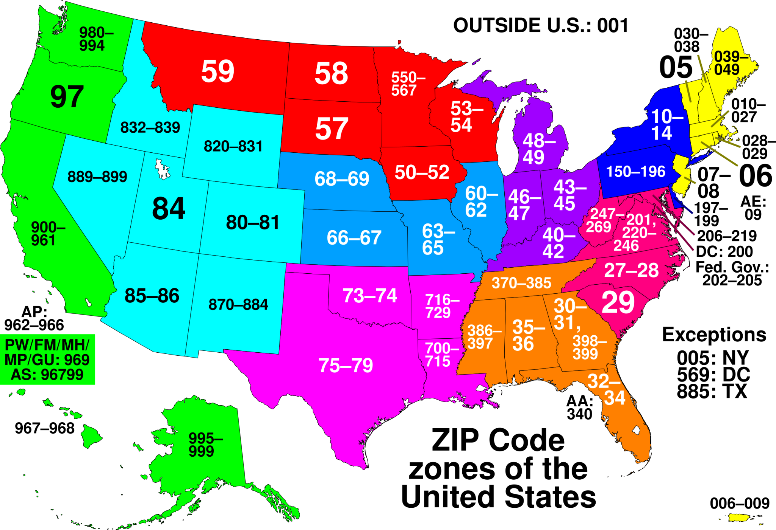
Postal (ZIP) codes are not randomly assigned!
If we stored ZIP as an integer, what could go wrong? Think about the northeast!

Slide 27
(we'll come back to this!)
Structure -- the "shape" of a data file
Granularity -- how fine/coarse is each datum → a single "piece" of data
Temporality -- how is the data situated in time
Faithfulness -- how well does the data capture "reality"
Key Data Properties to Consider in EDA

Slide 28
An Important Conundrum in Data Science
Singular "data" | "The data shows …"
Plural "data" (datums) | "The data show …"
The first one is technically incorrect, but in practice, either is fine 🙂

Slide 29
Granularity: How Fine/Coarse Is Each Datum?
Row 1
Row 1
Row 2
Row 3
Row 1
Row 2
Row 3
Fine
Grained
Coarse
Grained
What does each record (row) represent?
Examples: a single purchase, a single person, a group of users
Some data will include summaries (aka rollups) as records.
If the data are coarse, how were the records aggregated?
Summing, averaging, or something else?

Slide 30

Do not edit
How to change the design
What does each row of the `elections` dataset represent? In other words, what is granularity of `elections`?
Presenting with animations, GIFs or speaker notes? Enable our Chrome extension
Notes:
📣 This is Slido interaction slide, please don't delete it.
✅ Click on 'Present with Slido' and the poll will launch automatically when you get to this slide.

Slide 31
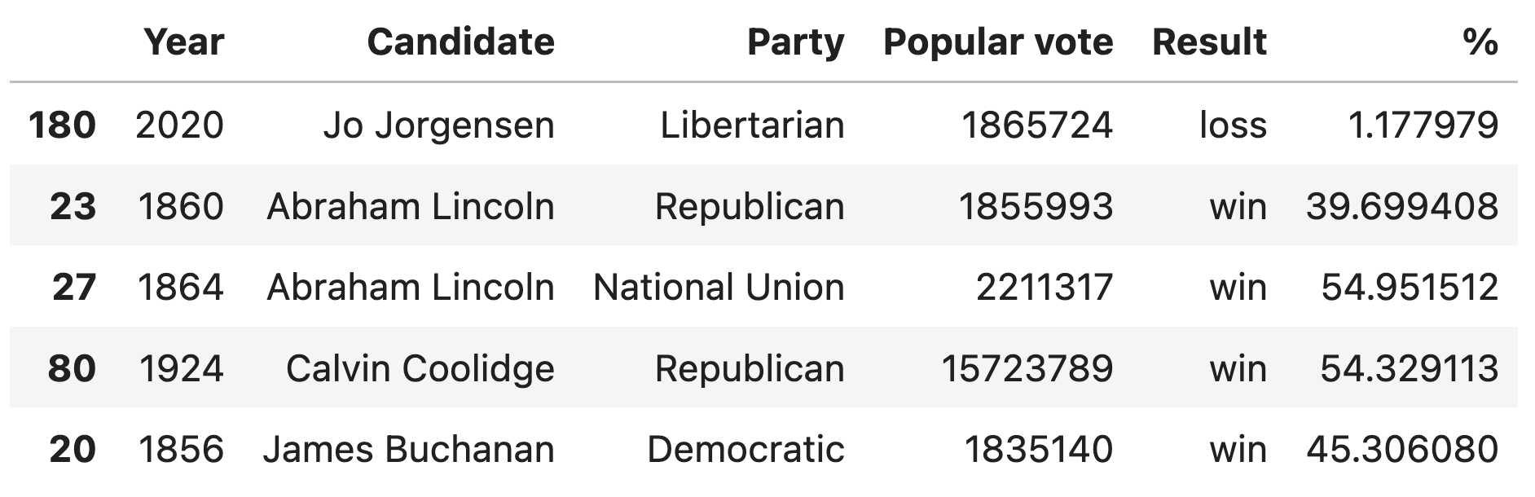
Granularity of elections
Each row of elections represents a unique combination of candidate and year.
Assumptions: One election per year and candidate represents one party per election.

Slide 32
Do not edit
How to change the design
What is the granularity of the `babynames` dataset?
Presenting with animations, GIFs or speaker notes? Enable our Chrome extension
Notes:
📣 This is Slido interaction slide, please don't delete it.
✅ Click on 'Present with Slido' and the poll will launch automatically when you get to this slide.

Slide 33
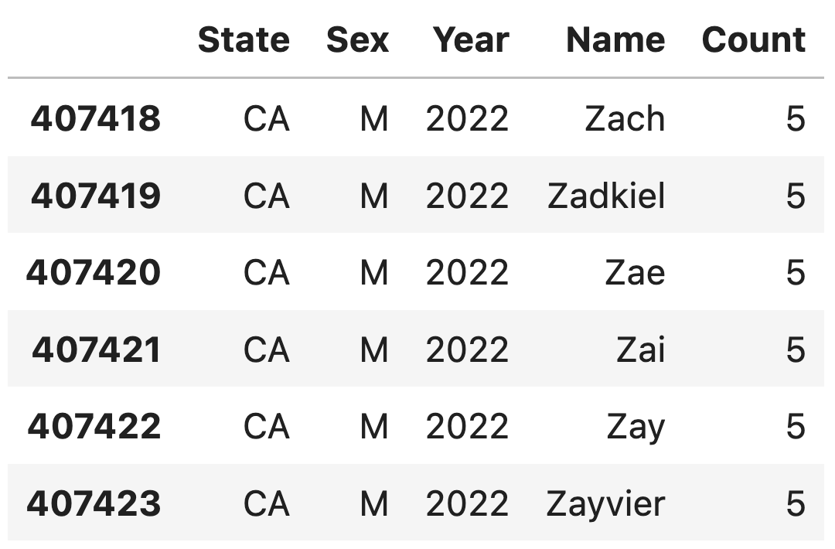
Granularity of babynames
Each row of babynames represents a unique combination of name, state, sex, and year.

Slide 34
Structure -- the "shape" of a data file
Granularity -- how fine/coarse is each datum
Temporality -- how is the data situated in time
Faithfulness -- how well does the data capture "reality"
Key Data Properties to Consider in EDA

Slide 35

What type of variable is a datetime (e.g., 01/01/2025 3:30pm)?
ⓘ
Click Present with Slido or install our Chrome extension to activate this poll while presenting.
Notes:
📣 This is Slido interaction slide, please don't delete it.
✅ Click on 'Present with Slido' and the poll will launch automatically when you get to this slide.

Slide 36
How Should We Store Datetimes?
As humans, we write datetimes as strings: 01/01/2025 3:30pm
First try: store as a categorical string, e.g. "010120250330p"
  Problem: difficult to make comparisons (before/after), do computation (how long between), etc.
  Problem: wastes space. Strings require more bits than numbers.
Better idea: store as numerical values
Computing standard: Unix/POSIX time
  Number of seconds* since January 1st 1970 UTC (Coordinated Universal Time)
    Example: Feb 4, 2025 5:00pm PDT → 1738674000 (1,738,674,000 seconds)
    Example: Feb 4, 1950 5:00pm PDT → -628167600 (-628,167,600 seconds)
  Easy to make comparisons, calculate “time between X and Y,” etc.

Slide 37
Variable Type
Multiple Files
File Format
Structure -- the "shape" of a data file
Granularity -- how fine/coarse is each datum
Temporality -- how is the data situated in time
Faithfulness -- how well does the data capture "reality"
Key Data Properties to Consider in EDA

Slide 38
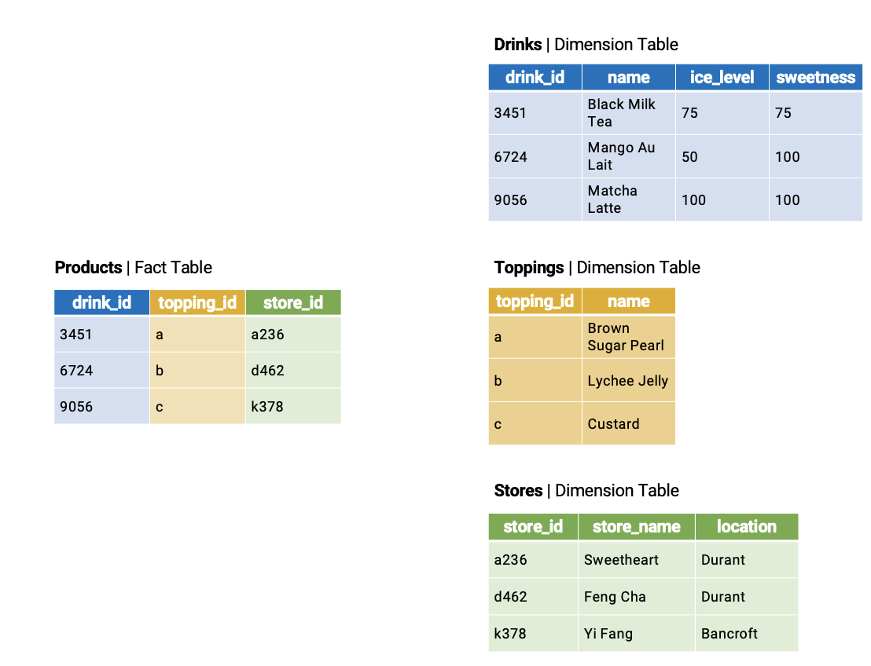
Multidimensional Data
To minimize redundant storage, databases store data across fact and dimension tables.
Fact table: Central table w/ info to link its entries to other dimension tables. Few columns, many records.
Dimension table: More detailed information about each type of fact. More columns and fewer records.
. . .
. . .
. . .
Granularity: Every possible drink+topping combinations across all stores. Lots of rows!

Slide 39
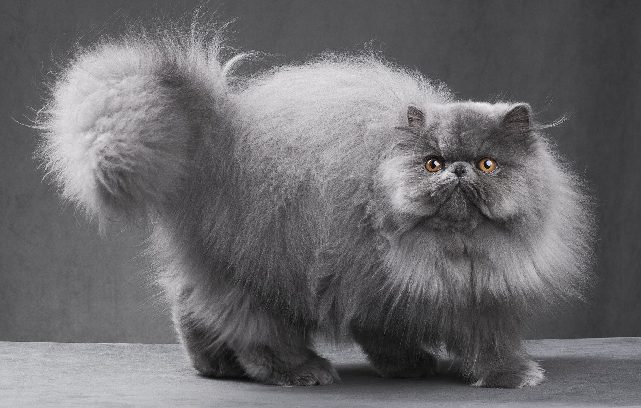


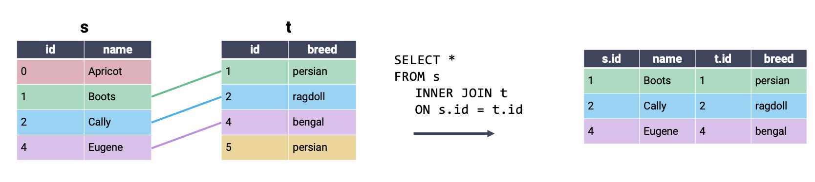

Cats
Persian
Ragdoll
Bengal
Helios*

Slide 40
Inner Join
Inner join: Combine every row from the first table with its matching entry in the second table. If a row does not have a match, it is omitted.

Slide 41
Inner Join
Inner join: Combine every row from the first table with its matching entry in the second table. If a row does not have a match, it is omitted.

Slide 42
JOIN Syntax
Specify joins between tables as part of the FROM statement
Desired type of join
SELECT *
FROM table1 INNER JOIN table2
ON table1.key = table2.key
What columns to use to determine matching entries

Slide 43
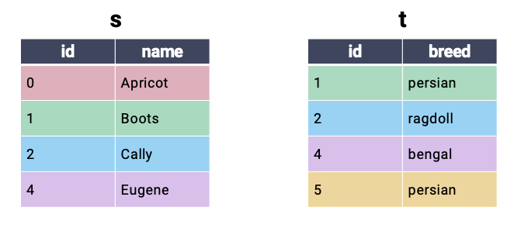
Cross Join
Cross join: Every combination of possible rows. Also called a cartesian product.

Slide 44
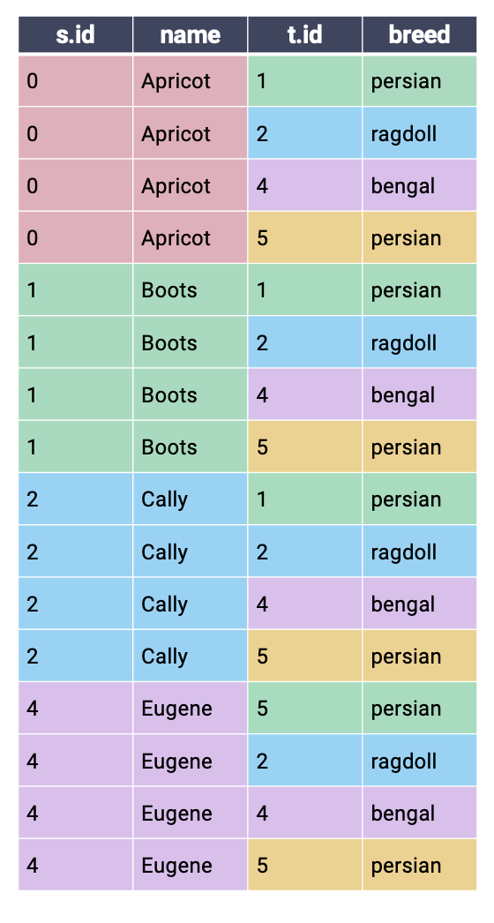
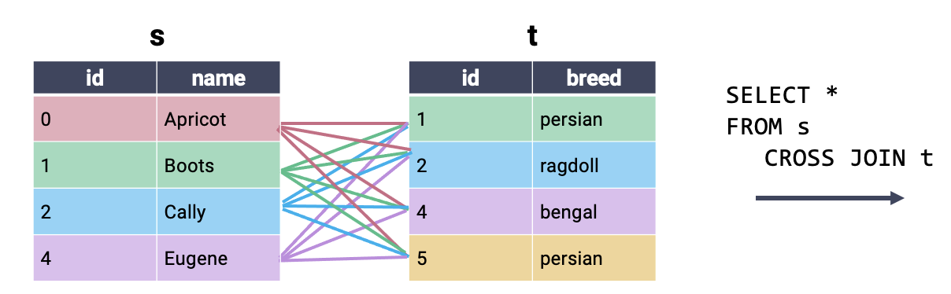
Cross Join
Cross join: Every combination of possible rows. Also called a cartesian product.
Notice that there is no need to specify a matching key (i.e., the columns to use for merging)

Slide 45
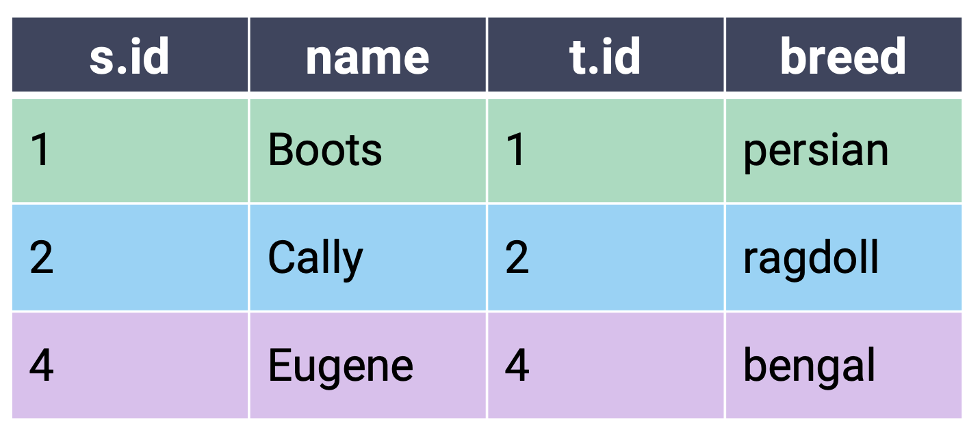
Inner Join: Cross Join With Filtering
Conceptually, you can imagine an inner join as a cross join filtered to include only matching rows.
SELECT *
FROM s CROSS JOIN t
WHERE s.id = t.id;
Equivalent
SELECT *
FROM s INNER JOIN t
ON s.id = t.id;

Slide 46
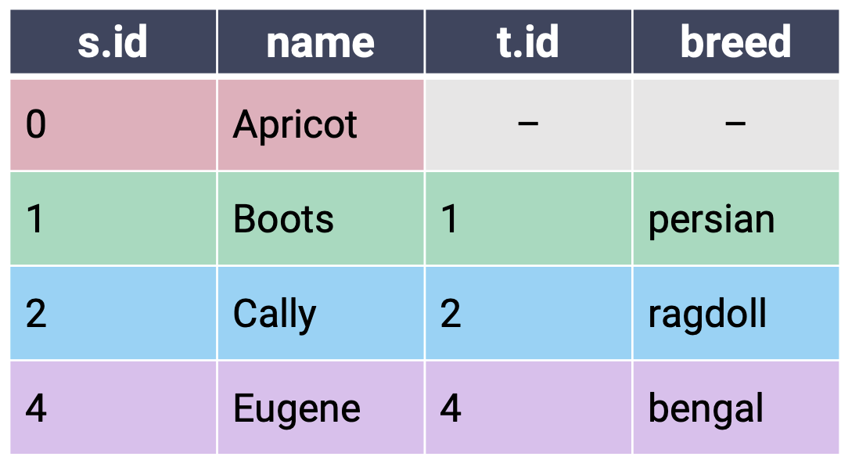
Left Outer Join
In a left outer join (or just left join), keep all rows from the left table and only matching rows from the right table. Fill NULL for any missing values.
SELECT *
FROM s LEFT JOIN t
ON s.id = t.id;
Fill values without matching entries in the right table with NULL
The “left table” is whichever table is referenced first in the JOIN statement.

Slide 47
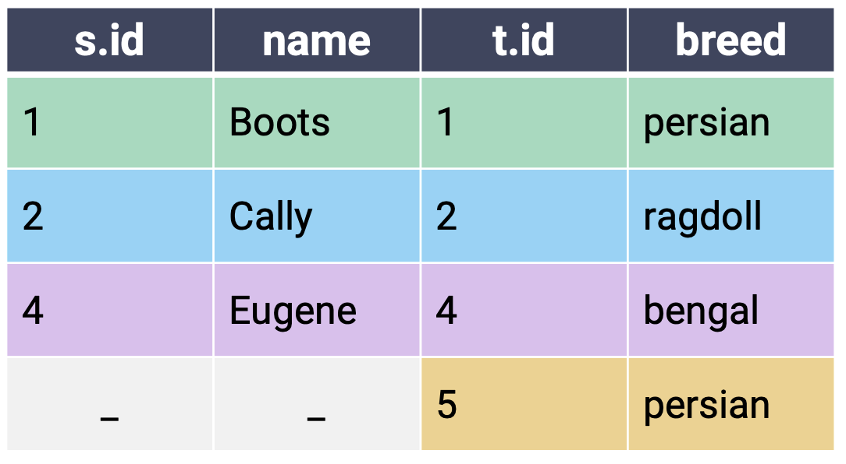
Right Outer Join
In a right outer join (or just right join), keep all rows from the right table and only matching rows from the left table. Fill NULL for any missing values.
SELECT *
FROM s RIGHT JOIN t
ON s.id = t.id;
The “right table” is whichever table is referenced second in the JOIN statement.

Slide 48
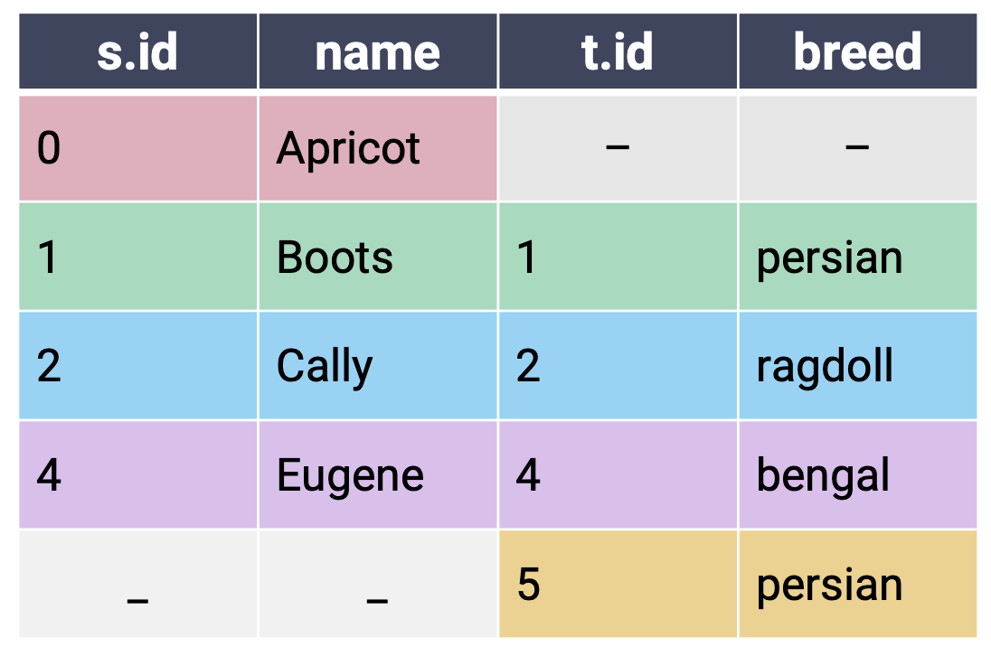
Full Outer Join
In a full outer join, keep all rows from both the left and right tables. Pair any matching rows, then fill missing values with NULL. Conceptually similar to performing both left and right joins.
SELECT *
FROM s FULL JOIN t
ON s.id = t.id;

Slide 49
Do not edit
How to change the design
Which of the following returns the same information as the SQL query at the top? Note: Column order does not matter.
Presenting with animations, GIFs or speaker notes? Enable our Chrome extension
Notes:
📣 This is Slido interaction slide, please don't delete it.
✅ Click on 'Present with Slido' and the poll will launch automatically when you get to this slide.

Slide 50
Equivalent Joins Slido
SELECT *
FROM s LEFT JOIN t
ON s.id = t.id;
SELECT *
FROM s LEFT JOIN t
ON t.id = s.id;
A
✅ Equality order does not matter.
SELECT *
FROM t RIGHT JOIN s
ON s.id = t.id;
B
✅ A right join is just a left join with the table order reversed. t.id and breed will now be the first two columns.
SELECT *
FROM s FULL JOIN t
ON s.id = t.id
WHERE s.id IS NOT NULL;
C
✅

Slide 51
Variable Type
Multiple Files
File Format
Structure -- the "shape" of a data file
Granularity -- how fine/coarse is each datum
Temporality -- how is the data situated in time
Faithfulness -- how well does the data capture "reality"
Key Data Properties to Consider in EDA

Slide 52
CSV: Comma-Separated Values
Flu data from CDC (source)
CSV is a very common tabular file format.
Records (rows) are delimited by a newline: '\n'
Fields (columns) are delimited by commas: ','
Pandas: pd.read_csv(header=...)
Fields/Attributes/Features/Columns
 | U.S. jurisdiction | TB cases 2019 | …
0 | Total | 8,900 | …
1 | Alabama | 87 | …
Records/Rows

Slide 53

TSV: Tab Separated Values
Another common table file format.
Fields are delimited by '\t' (tab)
Like a CSV with tabs instead of commas
pd.read_csv: Need to specify
delimiter='\t'
TaB soda: Precursor to Diet Coke

Slide 54
JSON: JavaScript Object Notation
CA Senators+Reps data (congress.gov API)
Very similar to Python dictionaries
Self-documenting: Metadata (data about the data) + records in the same file
pd.read_json()
pd.DataFrame(json_dict)
JSON is non-rectangular, so good to inspect the file before importing.
Nested tables
Inconsistent fields across records

Slide 55
Structure -- the "shape" of a data file
Granularity -- how fine/coarse is each datum
Temporality -- how is the data situated in time
Faithfulness -- how well does the data capture "reality"
Key Data Properties to Consider in EDA

Slide 56
Faithfulness: Do I trust this data?
Key Questions: How well does our data reflect reality? Are there discrepancies between what the data says and reality?
Some questions to help with the answers:
  Are there any biases in the data collection process?
  Who (or what) might not be represented in this data?
  Would the data look different if it were collected by someone else?
  Why is the data grouped/sliced the way it is?
  Were there relevant limitations in the data-gathering process?

Slide 57
What are some potential issues with this dataset? You can answer more than once.
ⓘ
Click Present with Slido or install our Chrome extension to activate this poll while presenting.
Notes:
📣 This is Slido interaction slide, please don't delete it.
✅ Click on 'Present with Slido' and the poll will launch automatically when you get to this slide.

Slide 58
What are Some Potential Issues with this Dataset?
ID | Category | State | Location | Device | Purchased | …
0 | Shoes | CA | CA | 1 | 1 | …
1 | Socks | NM | NM | 1 | 0 | …
2 | Socks | XY | XY | 1 | 0 | …
3 | Shirts | NY | NY | 1 | NA | …
4 | Shoes | FL | FL | 1 | 0 | …
4 | Shoes | FL | FL | 1 | 0 | …
5 | Shirts | CA | CA | 1 | 0 | …
6 | Pnts | TX | TX | 1 | 1 | …
7 | Hats | CA | CA | 1 | -1 | …
… | … | … | … | … | … | …

Slide 59
Faithfulness: Do I trust this data?
Fully Duplicated Records or Fields
Ignore/drop, if no reason for duplication.
Labeling or Spelling Errors
Apply corrections. Only ignore if you have to.
Missing data
Need to think carefully about why the data is missing.
Examples
" "
0, -1
999, 12345
1970, 2000
NaN
Null
NaN: "Not a Number"
Real zero or NaN placeholder? Sometimes both!
See footnote 12 in onlinelibrary.wiley.com/doi/abs/10.1111/jels.12343

Slide 60
Missing Data: Approaches
A. Keep as NaN
A good default.
If qualitative/categorical → Consider creating a "Missing" category.
B. Drop records with missing values
Typically a bad default!
Temperature probe went offline for a minute → Likely missing at random → OK to drop
Police officer never records outcomes of vehicle stops → Likely not missing at random
C. Imputation/Interpolation: Infer missing values
Mean/median imputation: replace NaN with mean/median
Hot deck imputation: use a random non-NaN value
Regression imputation: use a model to predict value
Multiple imputation: multiple random values + check sensitivity
(beyond this course)

Slide 61
Exploratory Data Analysis (EDA) IV
LECTURE 5
Data C100/Data C200, Fall @ UC Berkeley
Ramesh Sridharan and Jeremy Sanchez
Content credit: Acknowledgments

